Slide 1
CLASS MODELING

Slide 2
1. Steps to identify the Candidate CLASS from Given Requirements
identify the objects and derive classes from
identify attributes of classes
identify relationships between the classes;
write a data dictionary to support the class diagram;
identify class responsibilities
separate responsibilities into operations and attributes;

Slide 3
Noun Phrase Approach
Nouns in the textual description are considered to be classes and verbs to be methods of the classes.
All plurals are changed to singular, the nouns are listed and the list divided into
  relevant classes,
  fuzzy classes and
  irrelevant class.

Slide 4
Identifying tentative classes
Look for noun phrases and nouns in the use cases.
Some classes are implicit or taken from general knowledge.
All classes must make sense in the application domain.
Carefully choose and define class names.

Slide 5
Selecting classes from the relevant and fuzzy classes.
Redundant classes.
Adjective classes.
Attribute classes.
Irrelevant classes.

Slide 6
Example: Bank ATM system: Identifying classes by using noun phrase approach:
Initial list of Noun phrases candidate classes
Account
Account Balance
Amount
Approval process
ATM card
ATM machine
Bank
Bank client
Card
Cash
Check
Checking
Checking Account
Client
Client’s Account
Currency
Dollar
Envelope
Four digits
Fund
Savings
Savings Account
Step
System
Transaction
Transaction history
Invalid PIN
Message
Money
Password
PIN
Pin Code
Record

Slide 7
The following irrelevant classes are removed from the above list:
  Envelope
  Four Digits
  Step
Reviewing the Redundant classes and Building a common vocabulary:
Client, Bank client à Bank client
Account, Client’s Account à Account
PIN, PIN code à PIN
Checking, Checking Account à Checking Account
Savings, Savings Account à Savings Account
Fund, Money à Fund
ATM card, card à ATM card

Slide 8
Reviewing the classes containing adjectives
In this example, we have no classes containing adjectives that we can eliminate.
Reviewing the Possible Attribute
Amount à A value not a class
Account Balance à An attribute of the Account class
Invalid PIN à It is only a value, not class
Password à An attribute for Bank client class
Transaction history à An attribute of transaction class
PIN à An attribute of Bank client class

Slide 9
Reviewing the class purpose
The final candidate classes are:
  ATM machine class
  ATM card class
  Bank client
  Bank class
  Account class
  Checking Account class
  Savings Account class
  Transaction class

Slide 10
Example: Description of problem
R1 keep a complete list of all bikes and their details including bike number, type, size,
make, model, daily charge rate, deposit; (this is already on the Wheels system);
R2 keep a record of all customers and their past hire transactions;
R3 work out automatically how much it will cost to hire a given bike for a given number of days;
R4 record the details of a hire transaction including the start date, estimated duration, customer and bike, in such a way that it is easy to find the relevant transaction details when a bike is returned;
R5 keep track of how many bikes a customer is hiring so that the customer gets one unified receipt not a separate one for each bike;
R6 cope with a customer who hires more than one bike, each for different amounts of time;
R7 work out automatically, on the return of a bike, how long it was hired for, how many days were originally paid for, how much extra is due;
R8 record the total amount due and how much has been paid;
R9 print a receipt for each customer;
R10 keep track of the state of each bike, e.g. whether it is in stock, hired out or being repaired;
R11 provide the means to record extra details about specialist bikes.

Slide 11
FIRST: Underline the nouns and noun phrases
R1 keep a complete list of all bikes and their details including bike number, type, size, make, model, daily charge rate, deposit; (this is already on the Wheels system);
R2 keep a record of all customers and their past hire transactions;
R3 work out automatically how much it will cost to hire a given bike for a given number of days;
R4 record the details of a hire transaction including the start date, estimated duration, customer and bike, in such a way that it is easy to find the relevant transaction details when a bike is returned;
R5 keep track of how many bikes a customer is hiring so that the customer gets one unified receipt not a separate one for each bike;
R6 cope with a customer who hires more than one bike, each for different amounts of time;
R7 work out automatically, on the return of a bike, how long it was hired for, how many days were originally paid for, how much extra is due;
R8 record the total amount due and how much has been paid;
R9 print a receipt for each customer;
R10 keep track of the state of each bike, e.g. whether it is in stock, hired out or being repaired;
R11 provide the means to record extra details about specialist bikes.

Slide 12
SECOND: List of nouns
list of bikes , details of bikes: bike number, type, size, make, model, daily charge rate, deposit , Wheels system , record of customers , past hire transactions , bike, number of days, details of a hire transaction: start date, estimated duration, customer, receipt, different amounts of time, return of a bike, total amount due, state of each bike, extra details about specialist bikes

Slide 13
THIRD: Remove attributes nouns
list of bikes , details of bikes: bike number, type, size, make, model, daily charge rate, deposit , Wheels system , record of customers , past hire transactions , bike, number of days,
details of a hire transaction: start date, estimated duration, customer, receipt, different amounts of time, return of a bike, total amount due, state of each bike,extra details about specialist bikes

Slide 14
FOURTH: Remove redundancy/duplicates
list of bikes , details of bikes, Wheels system , record of customers , past hire transactions , bike, details of a hire transaction, customer, receipt, return of a bike, specialist bikes
FIFTH: Remove vague nouns
list of bikes , Wheels system , record of customers , hire transactions , bike, customer, receipt, return of a bike, specialist bikes

Slide 15
SIXTH: Remove nouns tied up with physical inputs and outputs
list of bikes , Wheels system , record of customers , hire transactions , bike, customer, receipt, specialist bikes
SEVENTH: Remove nouns that represent the whole system
Wheels system, hire transactions, bike, customer, specialist bikes
LIST OF CANDIDATE CLASSES: hire transactions, bike, customer, specialist bikes

Slide 16
Exercise 1
A school has a principal, many students, and many teachers. Each of these persons has a name, birthdate, and may borrow and return books. Teachers and the principal are both paid a salary; the principal evaluates the teachers. A school board supervises multiple schools and can hire and fire the principal for each school. A school has many playgrounds and rooms. A playground has many swings. Each room has many chairs and doors. Rooms include restrooms, classrooms, and the cafeteria. Each classroom has many computers and desks. Each desk has many rulers.

Slide 17
Exercise 2
A drive has multiple discs; a hard drive contains many discs and a floppy drive contains one disc. A disc is divided into tracks which are in turn subdivided into sectors. A file system may use multiple discs and a disc may be partitioned across file systems. Similarly a disc may contain many files and a file may be partitioned across many discs. A file system consists of many files. Each file has an owner, permissions for reading and writing, date last modified, size, and checksum. Operations that apply to files include create, copy, delete, rename, compress, uncompress, and compare. Files may be data files or directory files. A directory hierarchically organizes groups of presumably related files; directories may be recursively nested to an arbitrary depth. Each file within a directory can be uniquely identified by its file name. A file may correspond to many directory–file name pairs such as through UNIX links. A data file may be an ASCII file or binary file.

Slide 18
Class Diagram Case Study 1
An automobile is composed of a variety of parts. An automobile has one engine, one exhaust system, many wheels, many brakes, many brake lights, many doors, and one battery. An automobile may have 3, 4, or 5 wheels depending on whether the frame has 3 or 4 wheels and the optional spare tire. Similarly a car may have 2 or 4 doors. The exhaust system can be further divided into smaller components such as a muffler and tailpipe. A brake is associated with a brake light that indicates when the brake is being applied.
Notes:
Note that we made manufacturer an attribute of automobile, rather than a class that is
associated with automobile. Either approach is correct, depending on your perspective.
If all you need to do is to merely record the manufacturer for an automobile, the manufacturer
attribute is adequate and simplest. If on the other hand, you want to record details
about the manufacturer, such as address, phone number, and dealership information, then
you should treat manufacturer as a class and associate it with automobile.

Slide 19
Class Diagram Case Study 2
A gas heating system is composed of furnace, humidification, and ventilation subsystems.
The furnace subsystem can be further decomposed into a gas furnace, gas control, furnace thermostat, and many room thermostats. The room thermostats can be individually identified via the room number qualifier.
The humidification subsystem includes a humidifier and humidity sensor.
The ventilation subsystem has a blower, blower control, and many hot air vents. The blower in turn has a blower motor subcomponent.

Slide 20
Class Diagram Case Study 3
A castle has many rooms, corridors, stairs, towers, dungeons, and floors. Each tower and dungeon also has a floor. The castle is built from multiple stones each of which has dimensions, weight, color, and a composition material. The castle may be surrounded by a moat. Each lord lives in a castle; a castle may be without a lord if he has been captured in battle or killed. Each lady lives in a castle with her lord. A castle may be haunted by multiple ghosts, some of which have hostile intentions. Each room is connected to a corridor and one corridor connects another corridor.

Slide 21
Prepare a class diagram
Consider the air transportation system. Many flights land and depart from city’s airport. Some of the big cities may have more than one airports. Every flight belongs to specific airline. The planes may have many flights to different airports. Each plane is identified with serial number and model. There are specific pilots for each airline and they fly many flights. Each flight is identified by flight number and date on which flight is scheduled. The passenger reserves a seat for a flight. The seat is identified by a location.

Slide 22


Slide 23
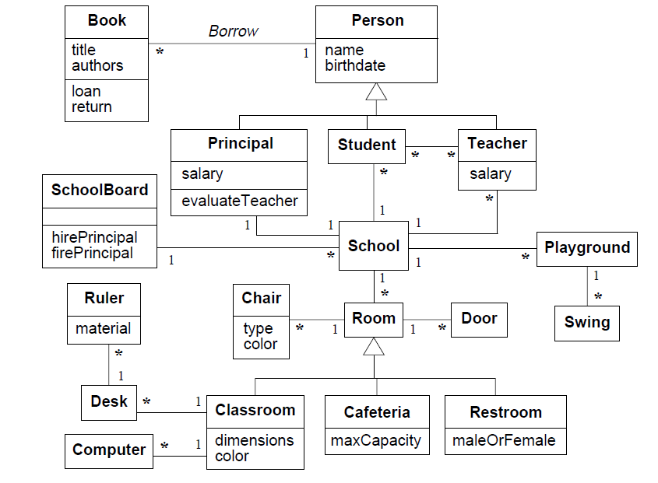

Slide 24
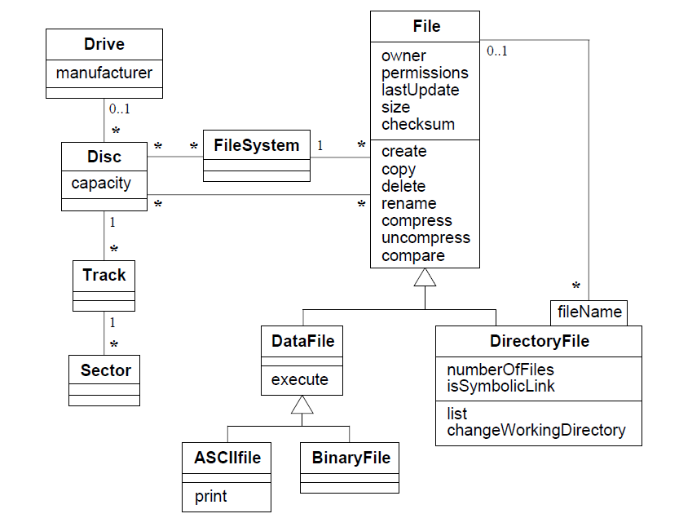

Slide 25
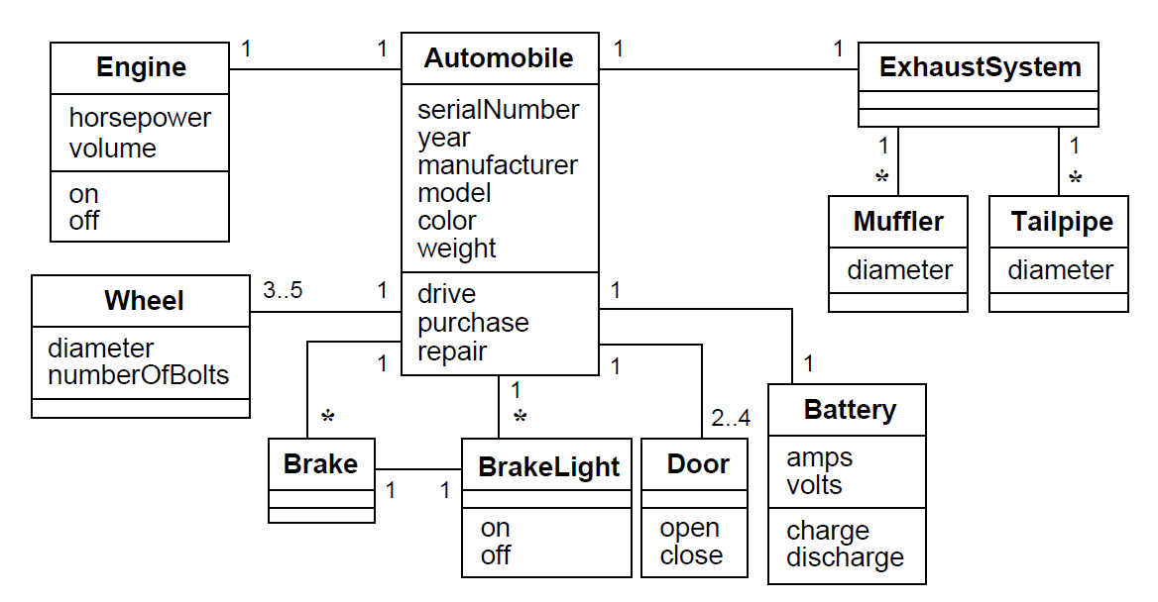

Slide 26
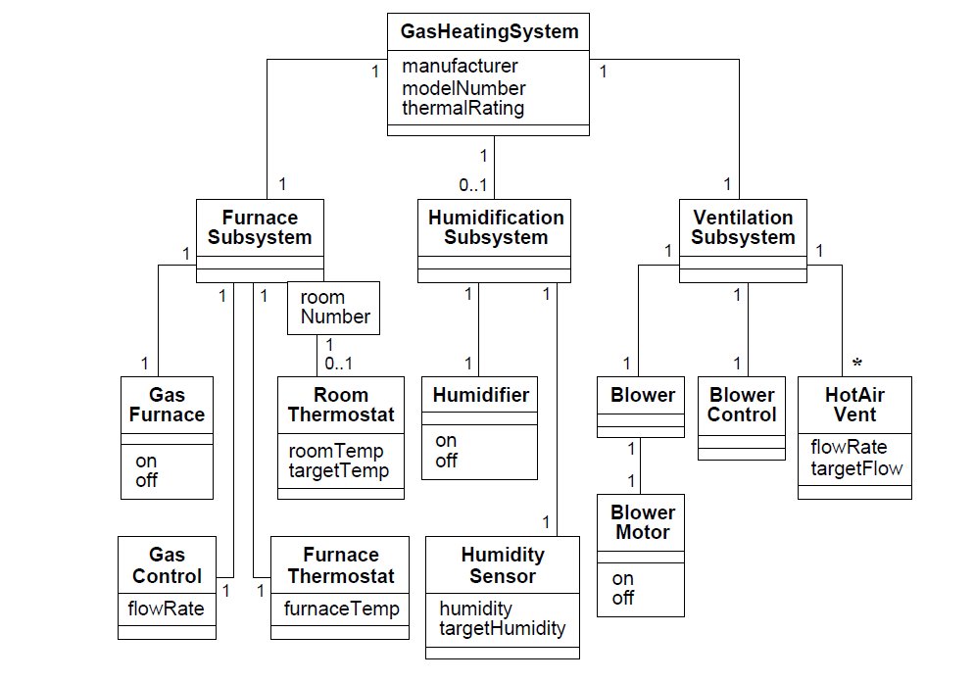

Slide 27
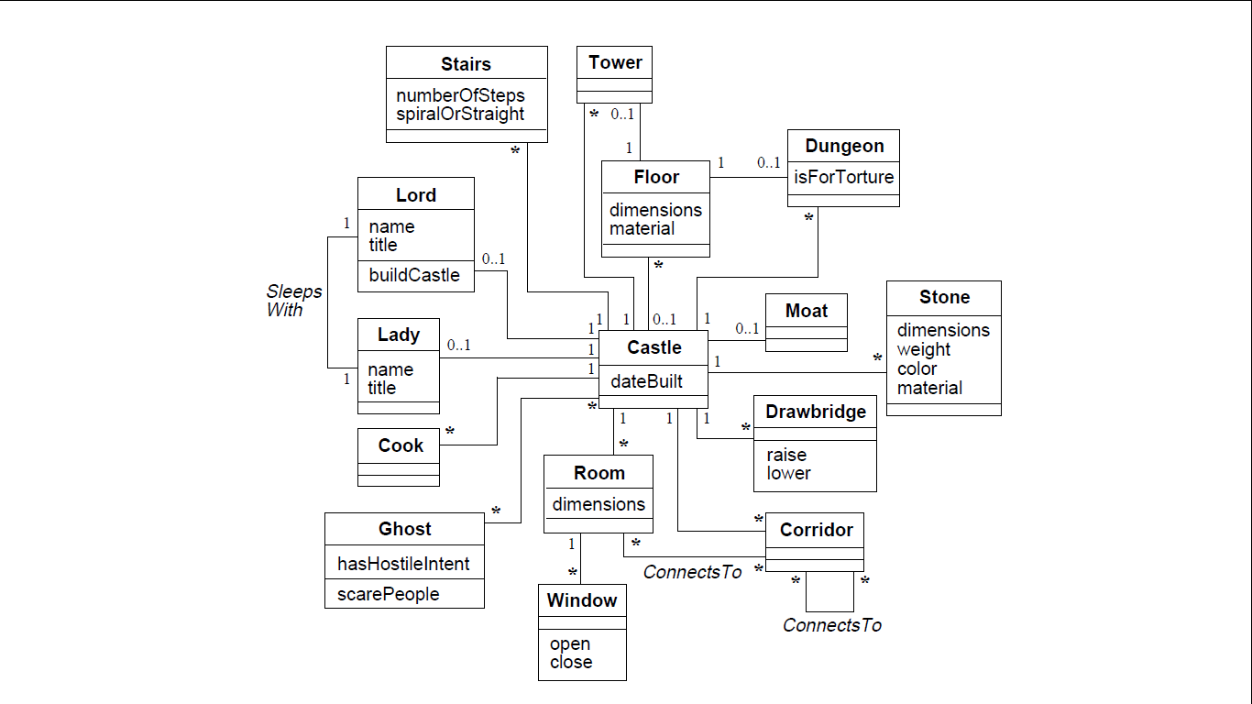

Slide 28
